Slide 1
Let’s Docker
By
Subrahmanyam Devarakonda

Slide 2
Virtualization
According to Wikipedia
In computing, virtualization refers to the act of creating a virtual (rather than actual) version of something, including virtual computer hardware platforms, storage devices, and computer network resources. Virtualization began in the 1960s, as a method of logically dividing the system resources provided by mainframe computers between different applications. Since then, the meaning of the term has broadened.
1
https://en.wikipedia.org/wiki/Virtualization
© Please be shameless to copy any slide you need 😁

Slide 3
Virtualization
2
© Please be shameless to copy any slide you need 😁

Slide 4
Containerization
According to Wikipedia
Operating-system-level virtualization, also known as containerization, refers to an operating system feature in which the kernel allows the existence of multiple isolated user-space instances. Such instances, called containers, partitions, virtualization engines (VEs) or jails (FreeBSD jail or chroot jail), may look like real computers from the point of view of programs running in them. A computer program running on an ordinary operating system can see all resources (connected devices, files and folders, network shares, CPU power, quantifiable hardware capabilities) of that computer. However, programs running inside a container can only see the container's contents and devices assigned to the container.On Unix-like operating systems, this feature can be seen as an advanced implementation of the standard chroot mechanism, which changes the apparent root folder for the current running process and its children. In addition to isolation mechanisms, the kernel often provides resource-management features to limit the impact of one container's activities on other containers.
3
https://en.wikipedia.org/wiki/Operating-system-level_virtualization
© Please be shameless to copy any slide you need 😁

Slide 5
Containerization
4
© Please be shameless to copy any slide you need 😁

Slide 6
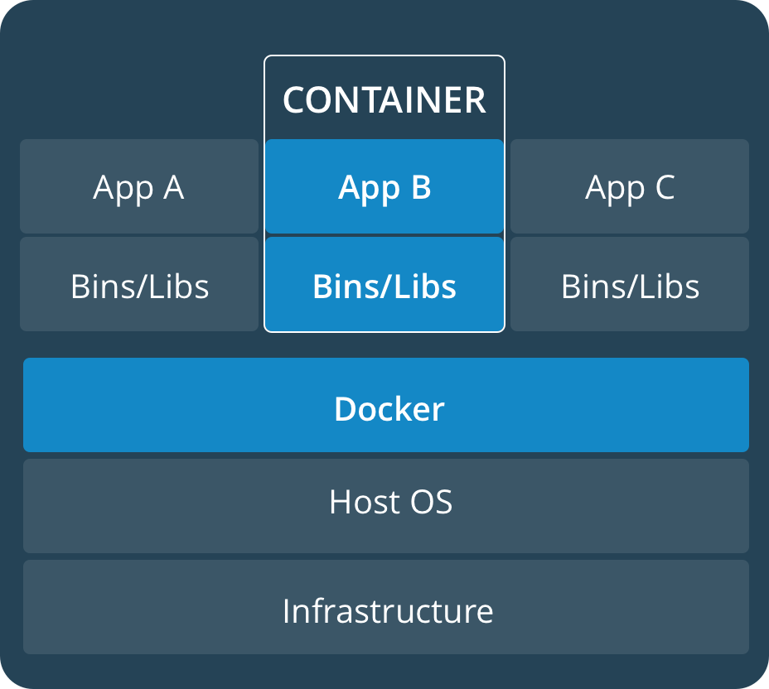
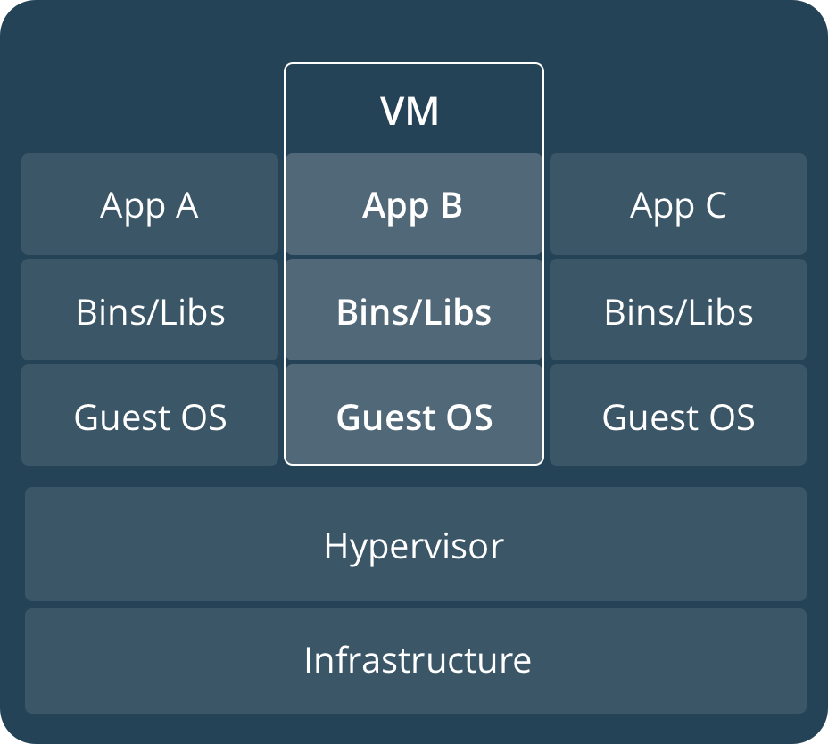
Containers vs Virtual Machines
5
© Please be shameless to copy any slide you need 😁

Slide 7
Docker Jargon’s
Images – A container is launched by running an Image. An Image is an executable package that includes everything needed to run an application – the code, a runtime, libraries, env variables and any config files.
6
Container – A container runs natively on Linux and shares the kernel of the host machine with other containers. It runs a discrete process, taking no more memory than any other executable, making it lightweight.
Service – It defines how containers behave in production.
Stack – It defines the interaction between services.
© Please be shameless to copy any slide you need 😁

Slide 8
Dockerfile
Dockerfile defines what goes on in the environment inside your container. Access to resources like networking interfaces and disk drives is virtualized inside this environment, which is isolated from the rest of your system, so you need to map ports to the outside world, and be specific about what files you want to “copy in” to that environment. However, after doing that, you can expect that the build of your app defined in this Dockerfile behaves exactly the same wherever it runs. Every directive in the Dockerfile would create a new layer on top of the base image.
I would recommend reading - https://devopscube.com/what-is-docker/ before proceeding any further.
7
© Please be shameless to copy any slide you need 😁

Slide 9
Docker-Compose & Docker-Machine
Well, each Docker container by default runs within the default network created by the Docker Engine.
What if we wanted to create a group of containers for each service in an application and make them share the same network? This is where Docker-Compose comes in.
Docker-Compose is service/container orchestration tool within the Docker tool-set.
This is done by creating a docker-compose.yml file which shares almost the same directives as a Dockerfile expect that it follows the yml/yaml document format.
Unless if you are using a Mac or Windows docker-compose would have to be installed separately.
The docker-compose build command builds the required images by reading the docker-compose.yml file.
The docker-compose up command spins up all the containers defined in the docker-compose.yml file.
The docker-compose down command brings down all the containers defined in the docker-compose.yml file.
However, full support for docker-compose is still not available on all cloud computation platforms.
Docker-Machine is another tool in the Docker tool-set which let us manage the creation of VM/VA necessary for orchestrating docker containers.
8
© Please be shameless to copy any slide you need 😁

Slide 10
What’s Kubernetes?
Kubernetes is an industry standard, accepted, proven and open-source container orchestration tool backed by Google.
When you need to run cluster of containers spread out across regions and capable of doing load balancing, this is where Kubernetes excels.
I would recommend reading the article on -https://www.xoriant.com/blog/cloud-infrastructure/introduction-kubernetes-building-blocks.html and - https://www.xoriant.com/blog/cloud-infrastructure/introduction-kubernetes.html
9
Image courtesy - https://www.xoriant.com/blog/cloud-infrastructure/introduction-kubernetes-building-blocks.html
© Please be shameless to copy any slide you need 😁

Slide 11
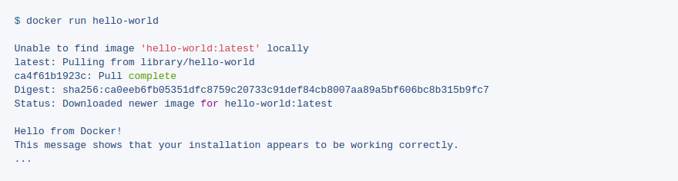
Hello World
10
© Please be shameless to copy any slide you need 😁

Slide 12
Rails with Docker
Well, there are multiple approaches to dockerizing a Rails App -
Approach 1 - We could could first create a Dockerfile and then generate an app. This approach would be beneficial to Dockerize if you are building an app from scratch.
Approach 2 – This approach would be helpful if we are trying to Dockerize an already existing rails app. We create a Dockerfile and docker-compose.yml files and spin-up using the docker-compose command.
Note : Either of the approaches would behave the same and wary in effort levels.
11
© Please be shameless to copy any slide you need 😁

Slide 13
Rails with Docker : Approach-1
In this approach, we first create a Rails App using the rails new app-name command and then proceed to create a Dockerfile. The Dockerfile, would contain the necessary directives to create an image with all the necessary binaries and libraries required to run the app in the Docker container. This Dockerfile can then be committed to a Docker Registry which can be re-used.
However, as the app evolves and starts adding dependencies on external tools like a RDBMS, KV Store, No-SQL Store etc.., we would have to switch to make use of Docker-Compose.
12
© Please be shameless to copy any slide you need 😁

Slide 14
Code Exercise
Lets start by creating a Dockerfile with the following contents
Next create a bootstrap Gemfile which just loads Rails, we shall overwrite in a moment when we run the rails new command.
Create an empty Gemfile.lock file.
FROM ruby:2.3.3
RUN apt-get update -qq && apt-get install -y build-essential libpq-dev nodejs
RUN mkdir /myapp
WORKDIR /myapp
COPY Gemfile /myapp/Gemfile
COPY Gemfile.lock /myapp/Gemfile.lock
RUN bundle install
COPY . /myapp
13
source 'https://rubygems.org'
gem 'rails', '5.0.0.1'
touch Gemfile.lock
© Please be shameless to copy any slide you need 😁

Slide 15
Code Exercise Contd...
Finally create a docker-compose.yml file with the following contents.
version: '3'
services:
db:
image: postgres
volumes:
- ./tmp/db:/var/lib/postgresql/data
web:
build: .
command: bundle exec rails s -p 3000 -b '0.0.0.0'
volumes:
- .:/myapp
ports:
- "3000:3000"
depends_on:
- db
14
© Please be shameless to copy any slide you need 😁

Slide 16
Code Exercise Contd...
Lets build the project
Once you are done, do a dir listing and you see the related rails app created locally.
If you are running Docker on Linux, the files that the rails new command created are owned by the root user. This happens because the container runs as the root user. If this is the case change the ownership of the new files.
Lets start building the docker image.
docker-compose run web rails new . --force --database=postgresql
15
sudo chown -R $USER:$USER
docker-compose build
© Please be shameless to copy any slide you need 😁

Slide 17
Code Exercise Contd...
The app is now bootable, but you’re not quite there yet. By default, Rails expects a DB to be running on localhost – so you need to point to the db container instead. You also need to change the database and username to align with the defaults set by the postgres image.
default: &default
adapter: postgresql
encoding: unicode
host: db
username: postgres
password:
pool: 5
development:
<<: *default
database: myapp_development
test:
<<: *default
database: myapp_test
16
© Please be shameless to copy any slide you need 😁

Slide 18
Code Exercise Contd...
Lets boot the app with docker-compose
If all is well you should see logs from from PostgreSQL (Note - The below box doesn’t show the complete log trace)
docker-compose up
17
Starting rails_db_1 ...
Starting rails_db_1 ... done
Recreating rails_web_1 ...
Recreating rails_web_1 ... done
Attaching to rails_db_1, rails_web_1
db_1 | LOG: database system was shut down at 2017-06-07 19:12:02 UTC
db_1 | LOG: MultiXact member wraparound protections are now enabled
db_1 | LOG: database system is ready to accept connections
db_1 | LOG: autovacuum launcher started
web_1 | => Booting Puma
web_1 | => Rails 5.0.0.1 application starting in development on http://0.0.0.0:3000
web_1 | => Run `rails server -h` for more startup options
web_1 | Puma starting in single mode...
© Please be shameless to copy any slide you need 😁

Slide 19
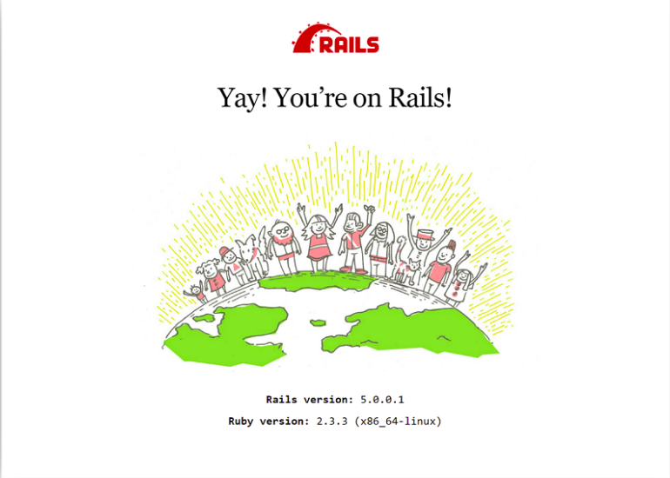
Code Exercise Contd...
In a new terminal window, run the rails rake command to create the db.
Once you are done, hit the http://localhost:3000 in your favorite browser :D.
docker-compose run web rake db:create
18
© Please be shameless to copy any slide you need 😁

Slide 20
Code Exercise Contd...
To stop the application, hit the following command in a seperate terminal window.
You can also stop the application by hitting Ctrl+C in the same shell, but when you try restarting the app using docker-compose up you might end up getting an error that the server is already running. This error occurs because the related server pid file is not cleared.
Anytime a change is made to the Gemfile or any of the Docker artefacts like the Dockerfile or docker-compose.yml file(s), you would have to re-build the image with the following command.
docker-compose down
19
docker-compose up --build
© Please be shameless to copy any slide you need 😁

Slide 21
Rails with Docker : Approach-2
In this approach, we start by defining a Dockerfile and progressively add a docker-compose.yml which would have all the related services that we intend to associate with the current app. The process of building the docker image would still be the same as in step Approach-1(Please referSlide-11 thru Slide-17).
20
© Please be shameless to copy any slide you need 😁

Slide 22
Traditional way of deploying applications
The very early way of deploying applications were more similar to the way they were built on our local machines.
All the elements like support systems, networks were all just a mimic of how they were built and used on our local machines.
As the need for larger infrastructure grew, so did the cost to maintain them grew.
An age of data-center’s with large infrastructure started.
This race too slowly started crunching into the overall cost to the company and a new age of computation was on the verge to un-fold.
The new age of computation was moving away from building physical machines to virtual machines.
The concept of virtual machines is what we have discussed in slides 1 and 2.
21
© Please be shameless to copy any slide you need 😁

Slide 23
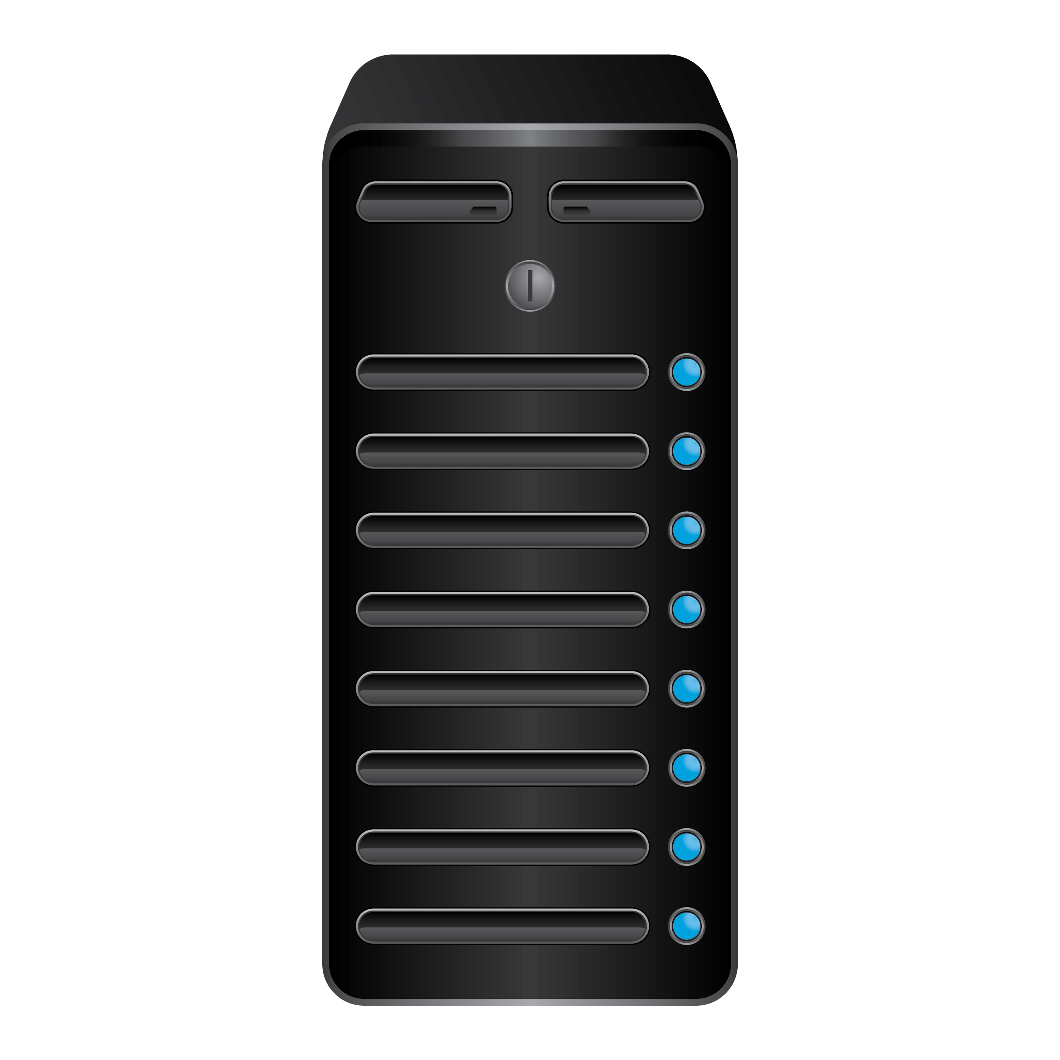
Traditional way of deploying applications
DEV
STG
PROD
22
Data Center
© Please be shameless to copy any slide you need 😁

Slide 24
Deploying applications using VM/VA
The way applications are deployed using a VM/VA has revolutionized from having a farm of physically wired machines serving 1-1 to the same physical machines serving 1-many VM/VA.
The idea is that the same physical machine can now be used to host many VM/VA using VM management software and SDN over hard-wired physical networks.
The hypervisor technology has revolutionized the computation world so much so that it has given birth some of the gaints in computation like AWS, Azure, DigitalOcean, Heroku etc.
Where once big-data computation was more limited to using Mainframes and Supercomputers, its more become a general commodity that even the tiniest of corporates can afford and on-demand.
23
© Please be shameless to copy any slide you need 😁

Slide 25
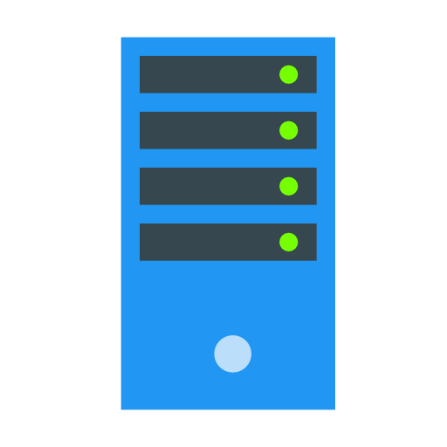
Deploying applications using VM/VA
DEV
STG
PROD
24
Data Center
© Please be shameless to copy any slide you need 😁

Slide 26
Deploying applications using containers
Containers have taken the computation a step further by slicing the use of VM/VA even further and bringing fine-grained and coarse-grained control of how much computation a individual service would need.
IoT would be the real benefactor of cloud computation using containerization.
Some of the cloud computation services have stepped onto providing serverless applications like Amazon Lambda, Azure Functions etc.
Serverless architecture simplifies service orchestration to the best.
25
© Please be shameless to copy any slide you need 😁

Slide 27
Online articles to read
https://docs.docker.com/compose/rails/
http://etherealmind.com/basics-docker-containers-hypervisors-coreos/
https://github.com/veggiemonk/awesome-docker
https://devopscube.com/what-is-docker/
https://docker-curriculum.com/
https://semaphoreci.com/community/tutorials/dockerizing-a-ruby-on-rails-application
https://blog.codeship.com/running-rails-development-environment-docker/
https://robots.thoughtbot.com/rails-on-docker
https://nickjanetakis.com/blog/dockerize-a-rails-5-postgres-redis-sidekiq-action-cable-app-with-docker-compose
https://github.com/ledermann/docker-rails - https://docker-rails.georg-ledermann.de/
https://medium.com/travis-on-docker/how-to-dockerize-your-ruby-on-rails-app-690b516cd872
https://www.xoriant.com/blog/cloud-infrastructure/introduction-kubernetes.html
https://www.xoriant.com/blog/cloud-infrastructure/introduction-kubernetes-building-blocks.html
26
© Please be shameless to copy any slide you need 😁

